Slide 1
DATA STRUCTURES & ALGORITHMS lab 08
Comp201l

Slide 2
Stack Implementation and operations
OBJECTIVE:
Implementation of stack using Array.
Implementation of stack using Linked list concepts.
Software/Tool:
Dev C++

Slide 3
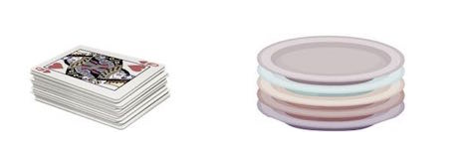
Stack
A stack is an Abstract Data Type (ADT)
Used in most programming languages
It is named stack as it behaves like a real-world stack
Stack allows operations at one end only.
For example –
Deck of cards
Pile of plates, etc.

Slide 4
Stack
This feature makes it LIFO data structure.
LIFO stands for Last-in-first-out.
We need to provide five operations to implement a stack. These operations are:
isEmpty(): check if stack is empty.
isFull(): check if stack is full.
push(): Pushing (storing) an element on the stack.
pop(): Removing (accessing) an element from the stack.
peek(): Get the top data element of the stack, without removing it.
Here, the element which is placed (inserted or added) last, is accessed first.

Slide 5
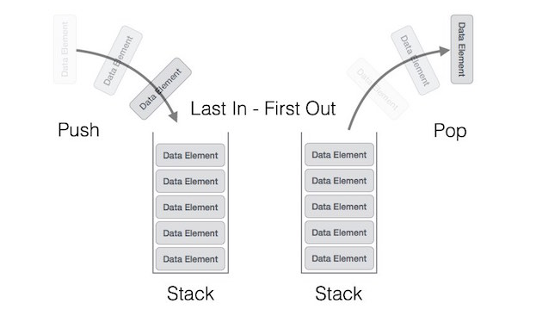
Stack – LIFO/FILO
In stack terminology, insertion operation is called PUSH operation and removal operation is called POP operation.

Slide 6
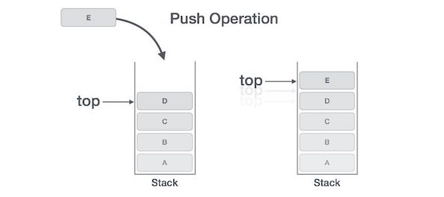
Stack – push operation
The process of putting a new data element onto stack is known as a Push Operation. This operation involves a series of steps:
Checks if the stack is full.
If the stack is full, produces an error and exit.
If the stack is not full, increments top to point next empty space.
Adds data element to the stack location, where top is pointing.
Returns success.
Note: If the linked list is used to implement the stack, then in step 3, we need to allocate space dynamically.

Slide 7
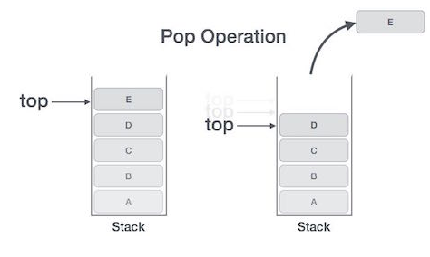
Stack – pop operation
Accessing the content while removing it from the stack, is known as a Pop Operation.
In an array implementation of pop() operation, the data element is not actually removed, instead top is decremented to a lower position in the stack to point to the next value.
But in linked-list implementation, pop() actually removes data element and de-allocates memory space.
A Pop operation may involve the following steps
Checks if the stack is full.
If the stack is full, produces an error and exit.
If the stack is not full, increments top to point next empty space.
Adds data element to the stack location, where top is pointing.
Returns success.
Note: If the linked list is used to implement the stack, then in step 3, we need to allocate space dynamically.

Slide 8
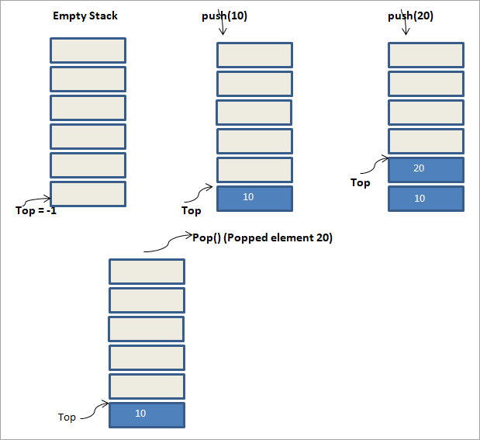
Example
Here is an illustration of stack.
Declaration of Top in stack.
How data elements are pushed into a stack.
How these elements are then popped.

Slide 9
Example
Sequence of operations, performed on the stack.
Initially, the stack is empty. For an empty stack, the top of the stack is set to -1.
Next, we push the element 10 into the stack. We see that the top of the stack now points to element 10.
Then another push operation with element 20, as a result of which the top of the stack now points to 20.
we perform a pop () operation. The element pointed at the top of the stack is removed from the stack.
The element 20 is removed from the stack. Thus the top of the stack now points to 10.
In this way, we can easily make out the LIFO approach used by stack.

Slide 10
Example: stack using arrays
void push(int v)
{
if(top==4)
cout<<"Stack is full"<<endl;
else
{
arr[++top]=v;
cout<<"Data pushed successfully"<<endl;
}
}
#include <iostream>
#include <conio.h>
using namespace std;
class Stack
{
private:
int arr[5];
int top;
public:
Stack()
{
top=-1;
}
int pop()
{
if(top==-1)
{
cout<<"Stack empty";
return 0;
}
else
return arr[top--];
}
};
int main()
{
Stack s;
s.push(10); s.push(20);
s.push(30);
s.push(40);
s.push(50);
s.push(60);
cout<<s.pop()<<endl;
cout<<s.pop()<<endl;
cout<<s.pop()<<endl;
cout<<s.pop()<<endl;
cout<<s.pop()<<endl;
cout<<s.pop()<<endl;
cout<<s.pop()<<endl;
}

Slide 11
Example: stack using Linked List
#include <iostream>
#include <conio.h>
using namespace std;
struct link
{
int data;
link *next;
};
class Stack
{
private:
link *top;
public:
Stack();
void push(int d);
int pop();
void show();
};
Stack::Stack()
{
top=NULL;
}
void Stack::push(int d)
{
link *ptr,*temp;
if(top==NULL)
{
top=new link;
top->data=d;
top->next=NULL;
}

Slide 12
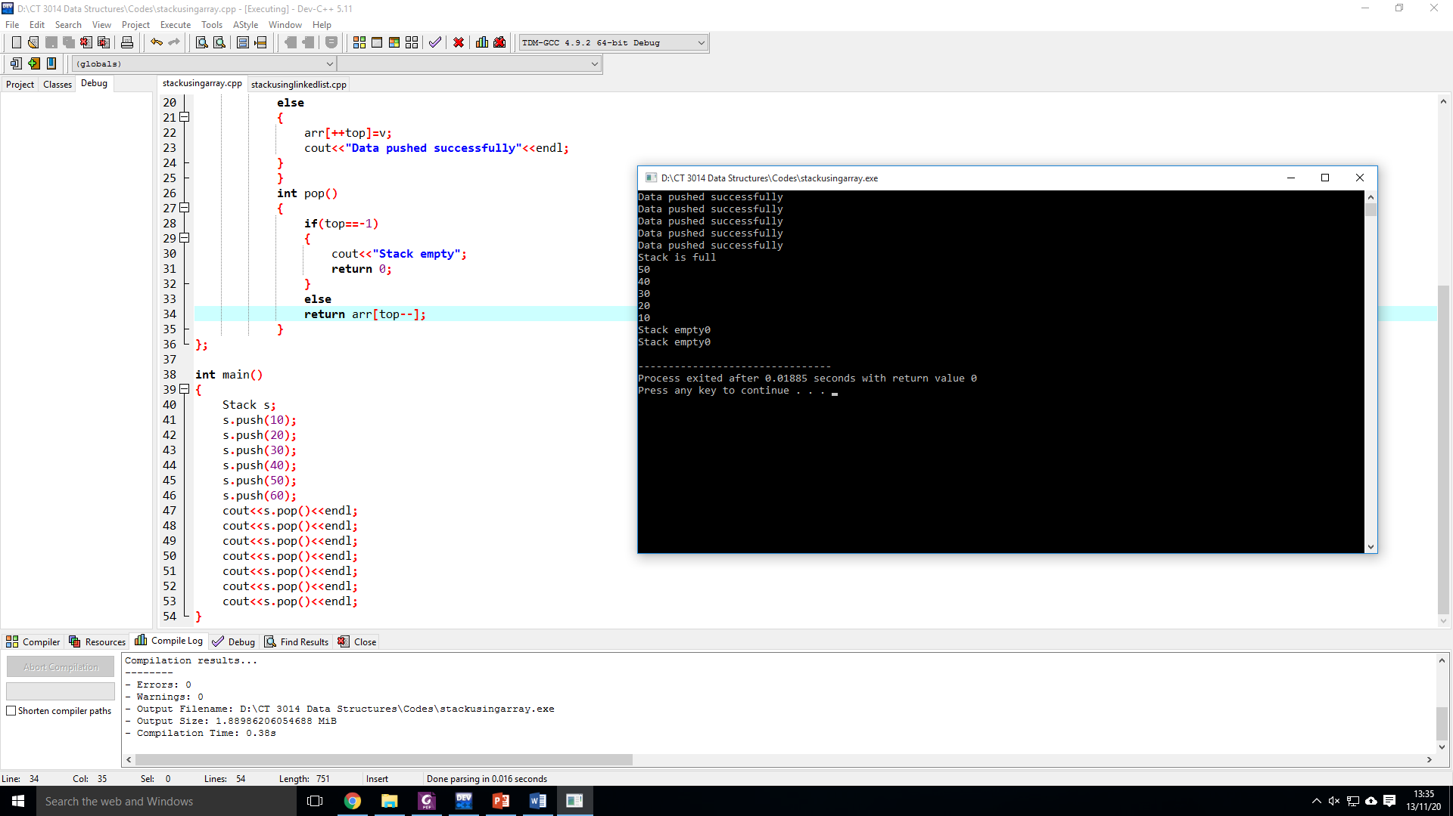
Example
Output of the Program

Slide 13
Example: stack using Linked List
else
{
ptr=top;
while(ptr->next!=NULL)
ptr=ptr->next;
temp=new link;
temp->data=d;
temp->next=NULL;
ptr->next=temp;
} }
void Stack::push(int d)
{
link *ptr,*temp;
if(top==NULL)
{
top=new link;
top->data=d;
top->next=NULL;
}
else {
ptr=top;
while(ptr->next!=NULL)
ptr=ptr->next;
temp=new link;
temp->data=d;
temp->next=NULL;
ptr->next=temp;
}}
int Stack::pop()
{
link *temp,*pre;
int n;
temp=top;
if(top==NULL)
{
cout<<"Stack empty"<<endl;
return 0;
}

Slide 14
Example: stack using Linked List
pre=temp;
while(temp->next!=NULL)
{
pre=temp;
temp=temp->next;
}
pre->next=NULL;
n=temp->data;
delete temp;
return n;}
void Stack::show()
{
link *temp;
temp=top;
while(temp!=NULL)
{
cout<<temp->data<<" ";
temp=temp->next;
} }
int main()
{
Stack s;
s.push(10);
s.push(20);
s.push(30);
s.push(40);
s.show();
cout<<endl;
s.pop();
s.pop();
s.show();
cout<<endl;
s.push(50);
s.show();
getch();
}

Slide 15
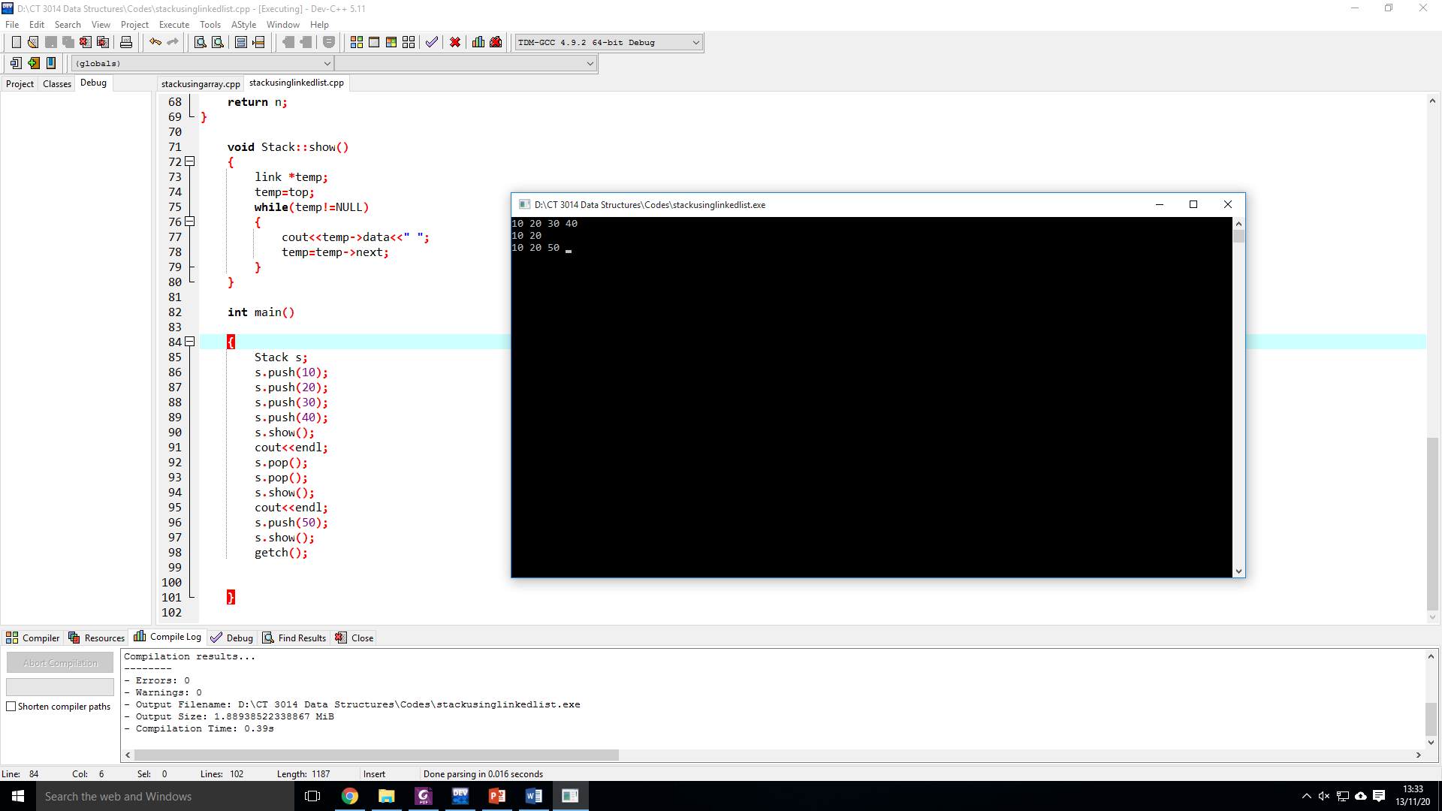
Example
Output of the Program:

Slide 16
Questions
Give one examples of stacks found in real life?
Write a program using C++ to generate a stack1 and push digits from 0 to 9. Then generate another stack that should pop the digits from the stack1 store in variables and push in stack 2 in such a way that the output should show your enrollment number.

